Slide 1
Bank of South Sudan Proof of Concept ( POC )
Michael Mbuthia
Regional Director East / South Africa
31st October 2023

Slide 2
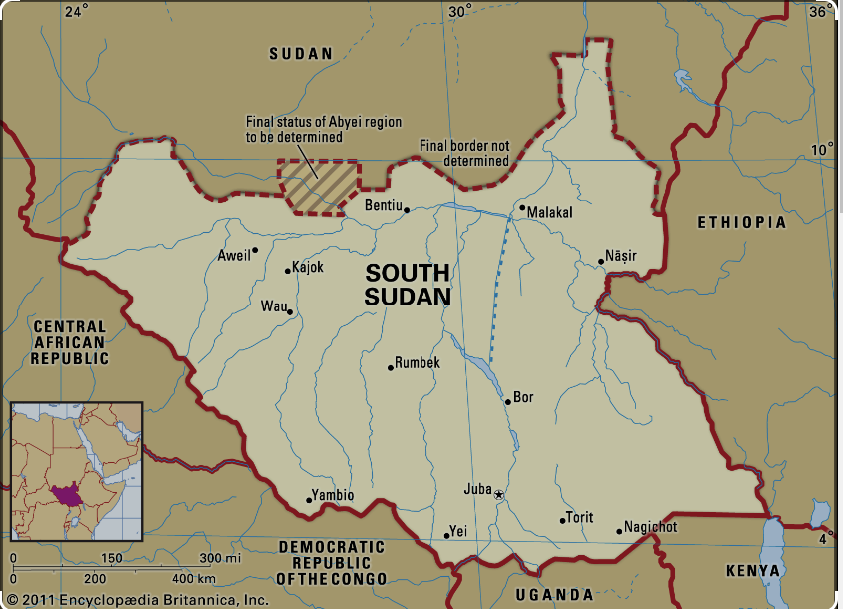
South Sudan
Area = 619,745 KMs
Population = +10 Million
Resources =
Petroleum,
Iron ore,
Copper,
Chromium ore,
Zinc, tungsten, mica, silver
Gold in Kapoeta area of Eastern Equatoria

Slide 3
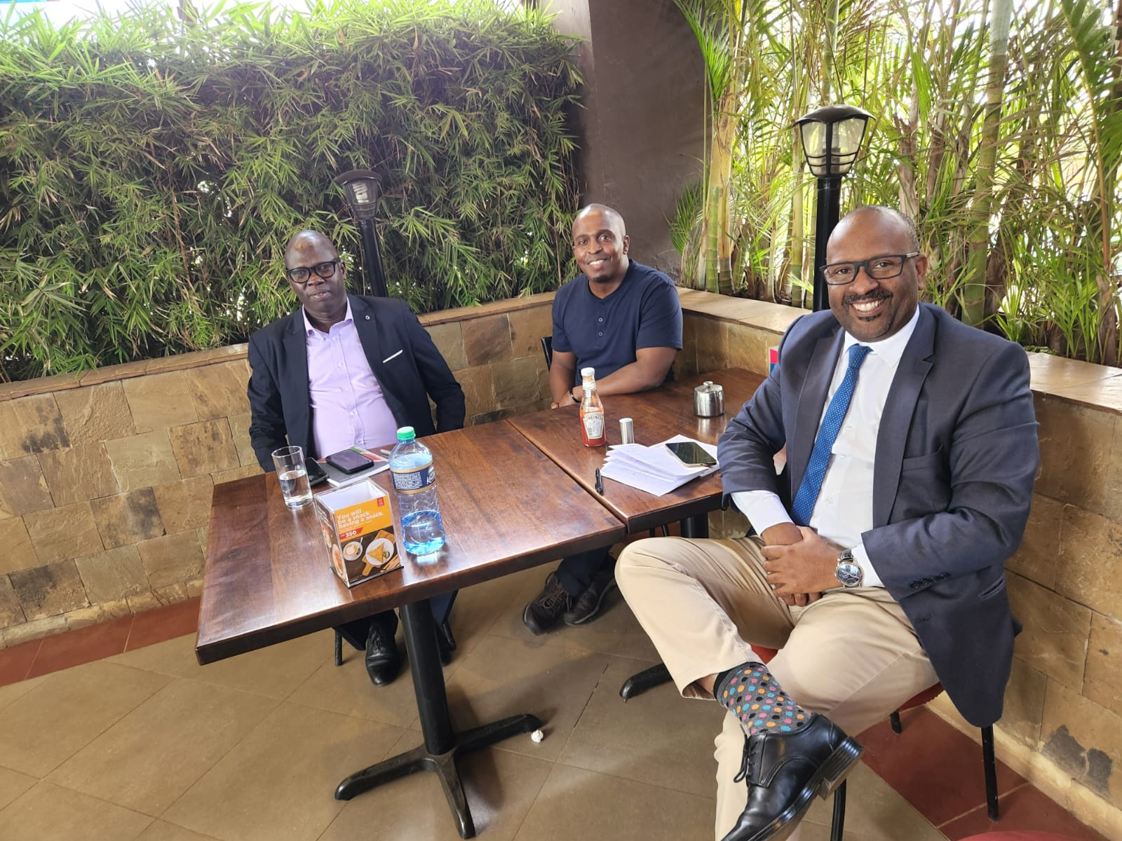
How it Started.. Coffee at Java

Slide 4

Land Scape Over-View ( The Opportunity )
The South Sudanese economy functions mainly on a cash basis. The use of cheque is low, there limited interbank money market, except for the manual cheques clearing house.
In the absence of an electronic system for handling inter-bank transactions, clearing banks meet at the Bank of South Sudan Clearing House to exchange paper instruments and establish their net settlement positions. Settlement is then effected on a deferred basis.
Currently Banks are the main providers of payment services in South Sudan. Twenty-eight Commercial Banks are licensed to operate, six of which are foreign-owned.
Regulations have been drafted and two strong mobile players are present in the market I.e. MTN Momo and MGurush ( Operated by Trinity Technologies ) with MTN Momo having the largest market share.

Slide 5

BOSS National Payments Status
The Republic of South Sudan (RSS) is in the process of developing National Payment System (NPS) and has a number of payment and settlement systems under development.
National Payment Systems objectives initiatives completed include;
Development of NPS Vision and Strategy Framework.
Review of South Sudan Legal and Regulatory framework for payment systems.
Development of NPS Oversight Framework and capacity building activities.
The procurement of an Automated Transfer Systems (ATS) - Hybrid system comprising of three components (RTGS, ACH and CSD) which is currently under implementation.
Setting up of a Tier 3 Data Center, business continuity plans and disaster recovery sites at BOSS.

Slide 6
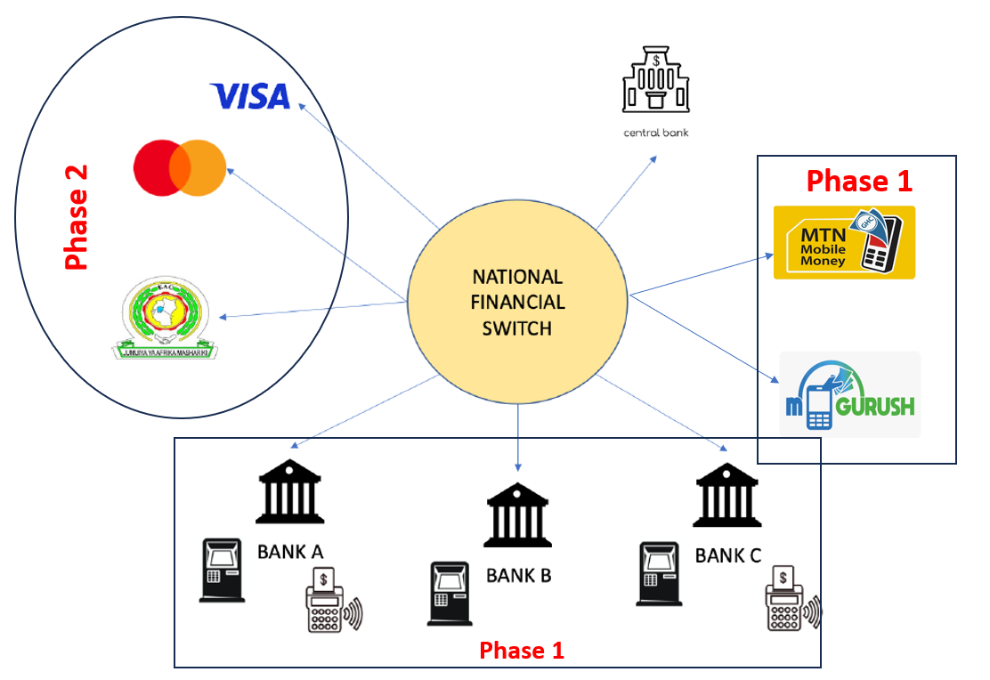
POC Objectives
Demonstrate Mojaloop Hub in action for selected use cases and business processes at production security grade via on-premise or cloud hosting.
Conduct User acceptance testing of core hub processes in action with selected financial services participants.
Support Bank of South Sudan to connect at least four “4” financial services participants to the cloud environment and on-premises infrastructure; and checklist the integration process to make it future repeatable efficiently and independently.
Support financial services participants to deliver a user experience demo around initial person to person use case in an interoperable manner that instantly clears funds and facilitates net settlement between participants.

Slide 7
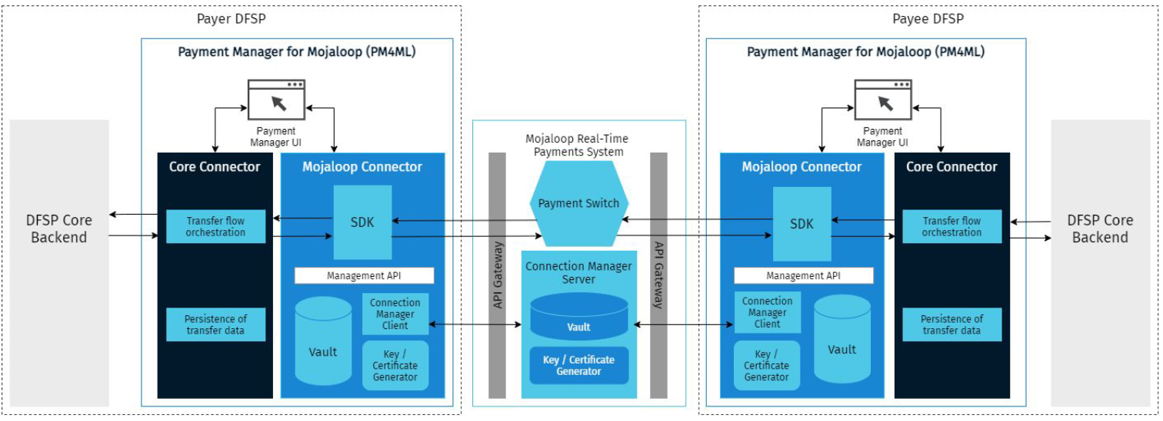
Technical Design
Mojaloop Core Platform Hosted on AWS

Slide 8
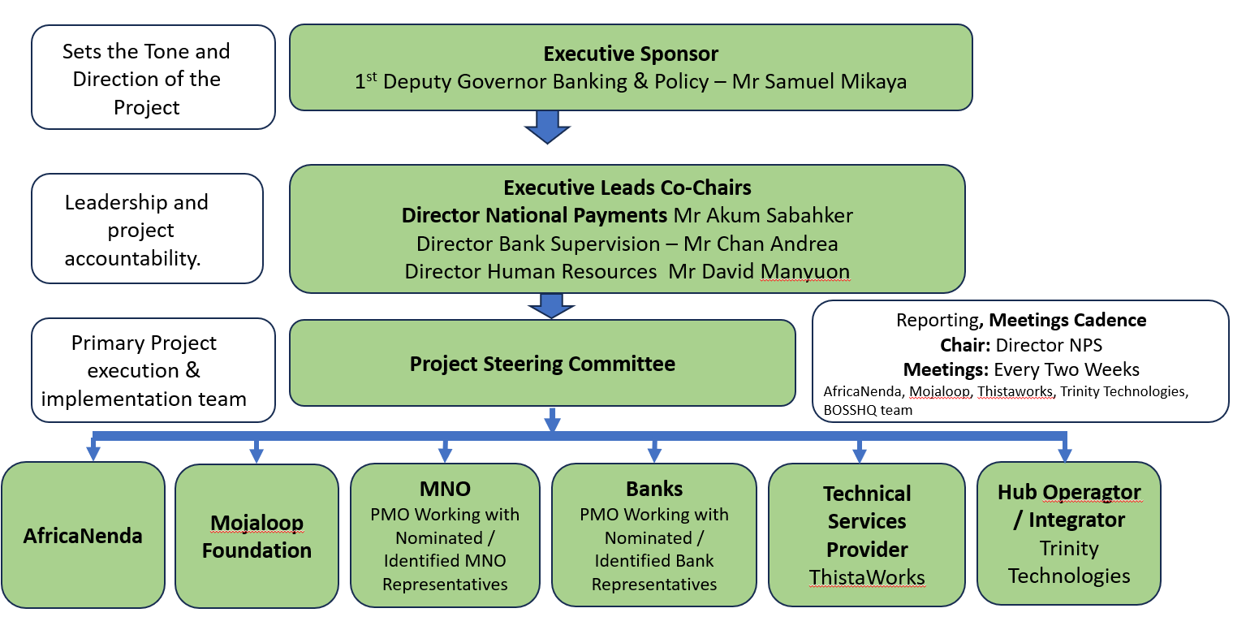
Governance Structure

Slide 9
Q4 ACTIVITIES
September
October
November
December
1.Setup
1. Contracting ( TTL & ThistaWorks )
2. Proof of Concept Environment Setup
3. Governance Setup ( Project & Technical Teams )
2.Governance
4. Mojaloop Technical Training(TTL-Thistaworks-AN-BOSS)
5. Onboarding API Technical Training (TTL-Thistaworks-AN-BOSSHQ)
3.Training
6. L1P Training ( TTL-Thistaworks-AN-BOSSHQ-AN-Glenbrook )
7. Onboarding Digital Financial Services Providers (x3)
8. Operational E2E Testing
5.Deployment
9. POC Documentation – Validation
October Week 3-4 Activities
November - December Week 1 Activities
1. Mojaloop Technical Training
- Date: 17th October 2023 (Tuesday) - Time: 10:00 AM to 11:30 AM (Juba Time)
2. DSFP Onboarding Process Training
- Date: 20th October 2023 (Friday) - Time: 10:00 AM to 11:30 AM (Juba Time)
1. L1P Payment Training ( BOSS, TTL, AN, Glenbrook, AfricaNenda )
2. DFSP onboarding
3. E2E Testing
4. Poc Documentation & Validation

Slide 10
South Sudan Mojaloop POC Demo – Su Mon Aung
Transaction Making
Logs Checking in Grafana
Transaction Checking in Payment Manager Portal on both Payer and Payee sides
Settlement Window closing and Transaction Checking in Finance Portal
Settlement Report Generating – DFSP Settlement Report and DFSP Settlement Detailed Report for both DFSPs

Slide 11
POC Success Factors
Strong
Regulatory
Support
Strong Tech
THITSAWORKS
BANK OF SOUTH
SUDAN
Partner
Strong DPG
Mojaloop
Strong System / Hub
Operator
TRINITY TECHNOLOGIES

Slide 12
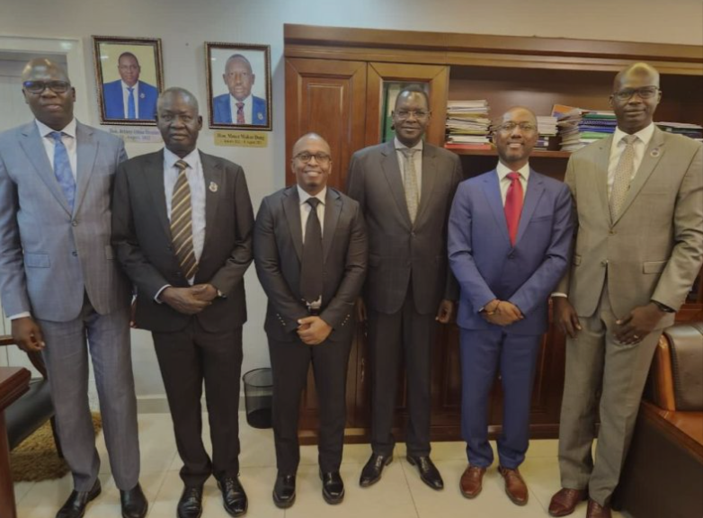
Thank you!

